Slide 1
NODE.JS
(The Backend Of MERN Stack)
Lecture 44

Slide 2
Today’s Agenda
What Is Passport JS ?
Benefits
Passport Strategies
A Working Example For Login Authentication
Exercise

Slide 3
What is passport js ?
Passport is a robust NodeJS package that easily allows a developer to incorporate login/logout functionality into applications.
With it, we can easily integrate the authentication mechanism into any Node-Express-based app with few lines of code.

Slide 4
benefit
The most important benefit of using passport and its allied packages is that all the heavy lifting required for authentication and authorization is done by the server like:
saving the user credentials in DB.
reading and validating credentials from DB.
verifying whether a user is logged in or not before accessing any protected page.

Slide 5
About passport strategies
Strategies in Passport are authentication mechanisms i.e the way we want Passport to validate a user during login.
The Passport library provides more than 500 strategies created to suit individual means of authentication , like:
passport-local: Uses local username and password authentication.
passport-facebook: To authenticate with Facebook.
passport-twitter: To authenticate with Twitter.
passport-google: To authenticate with Google.

Slide 6
Which strategy we will use?
We will be using local authentication with mongoose in this course.
It means we will use Passport/Mongoose combination to:
set up our DB .
add user credentials in the DB .
validate these credentials at the time of login .

Slide 7
What we will do ?
In this example we will create a functional login page with complete authentication and authorization having the following features:
A login form for a Node application using Passport.
Using the session authentication strategy with Passport.
Connecting Passport to a MongoDB database to store user data
Authorizing only logged-in users to access a secret page.

Slide 8
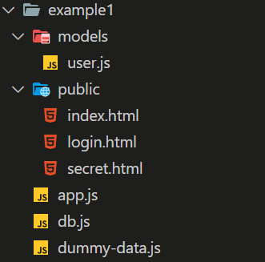
Application structure

Slide 9
Packages required
We will need a total of 7 packages as listed below:
Package | Purpose
express | The Express framework for our web application
express-session | To create and manage the sessions
mongoose | To connect with MongoDB
passport | The authentication library
passport-local | The authentication strategy
passport-local-mongoose | To integrate mongoose with passport-local
connect-ensure-login | The authorization middleware that makes it easy to restrict access to pages.

Slide 10
Installing required packages
To begin with we will install all the 7 packages using the npm install command:
npm install express express-session mongoose passport passport-local passport-local-mongoose connect-ensure-login
Next, we will create our db.js and develop the 3 static html pages inside the public folder of the application.

Slide 11
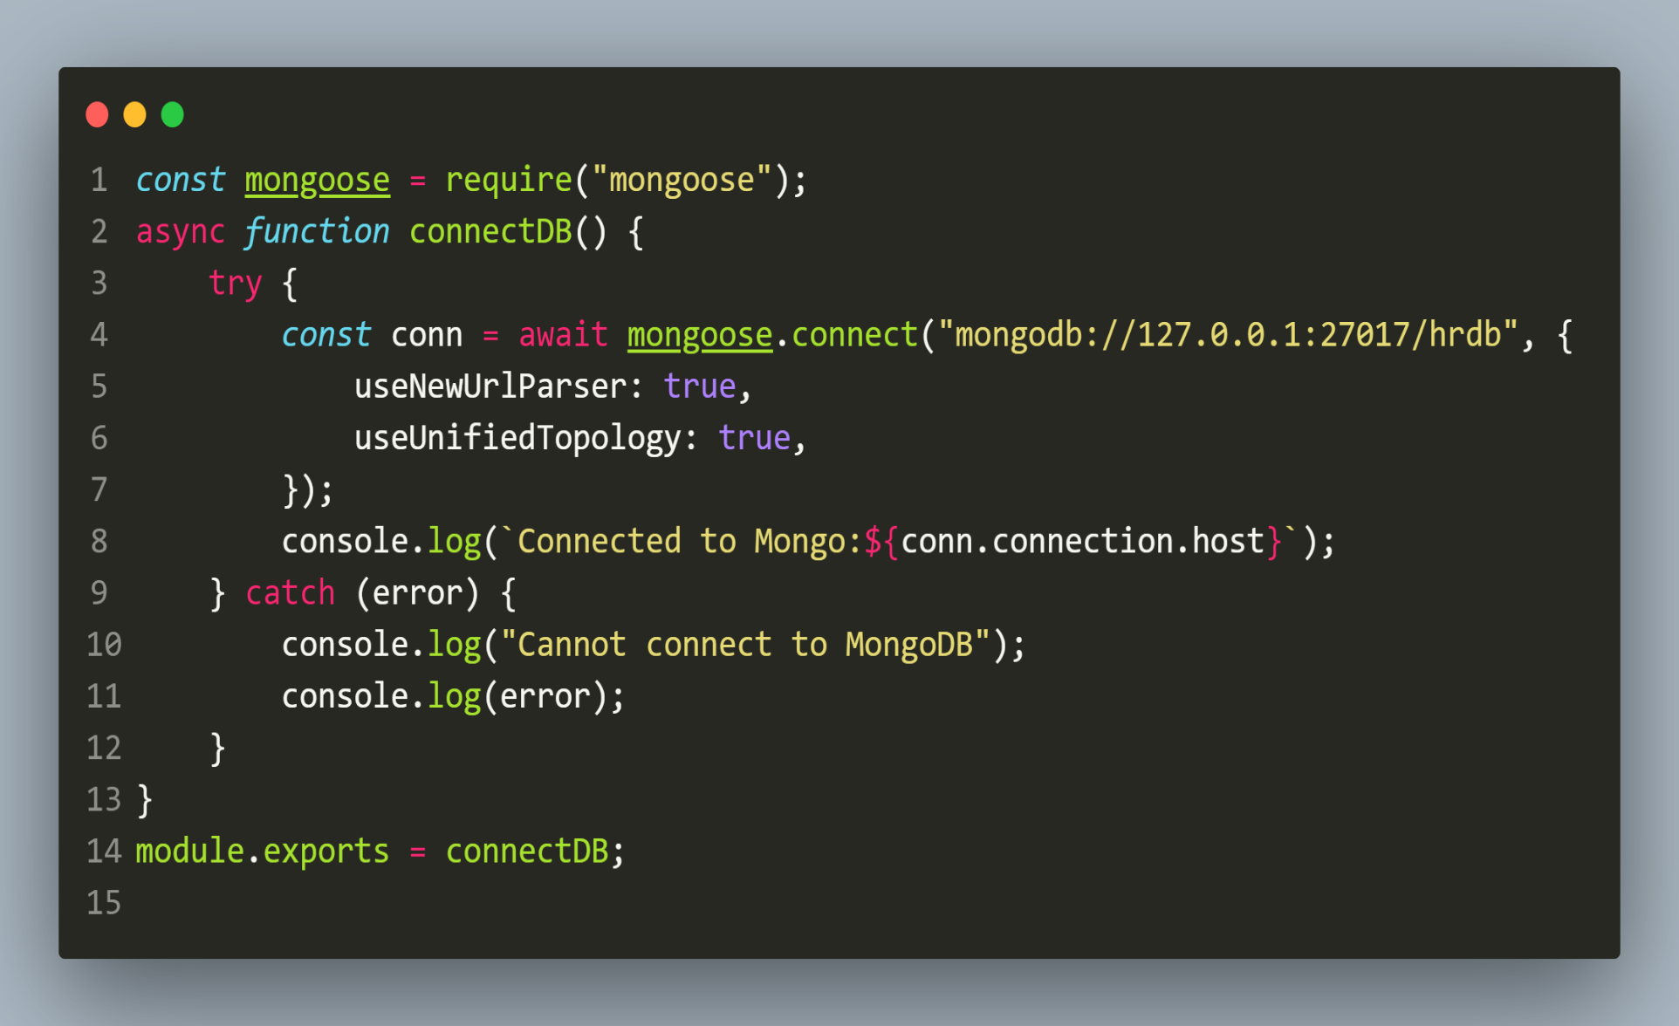
The db.js FILE

Slide 12
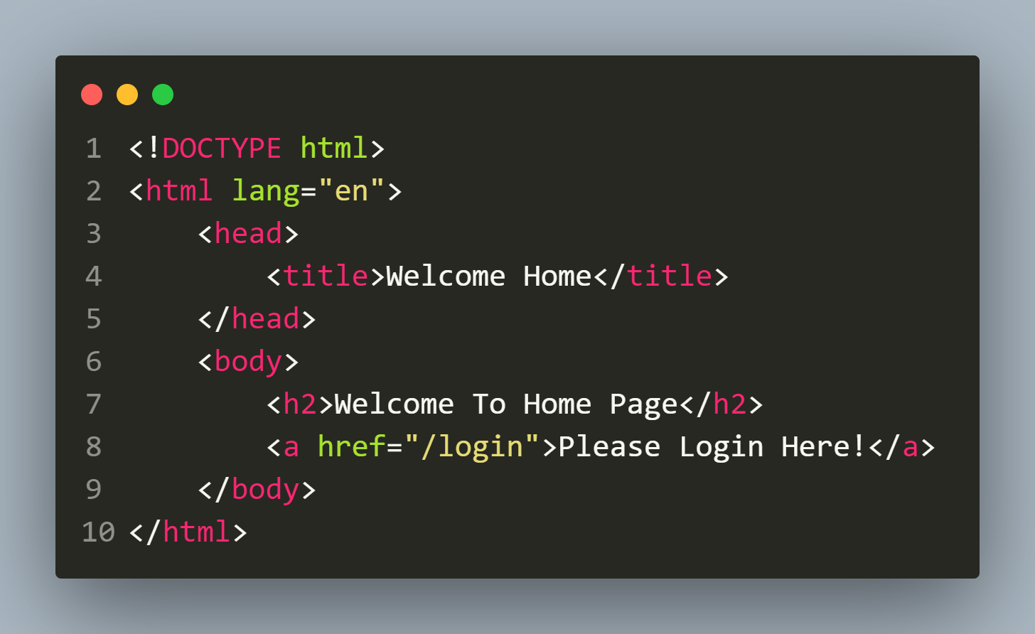
Creating html pages
public/index.html

Slide 13
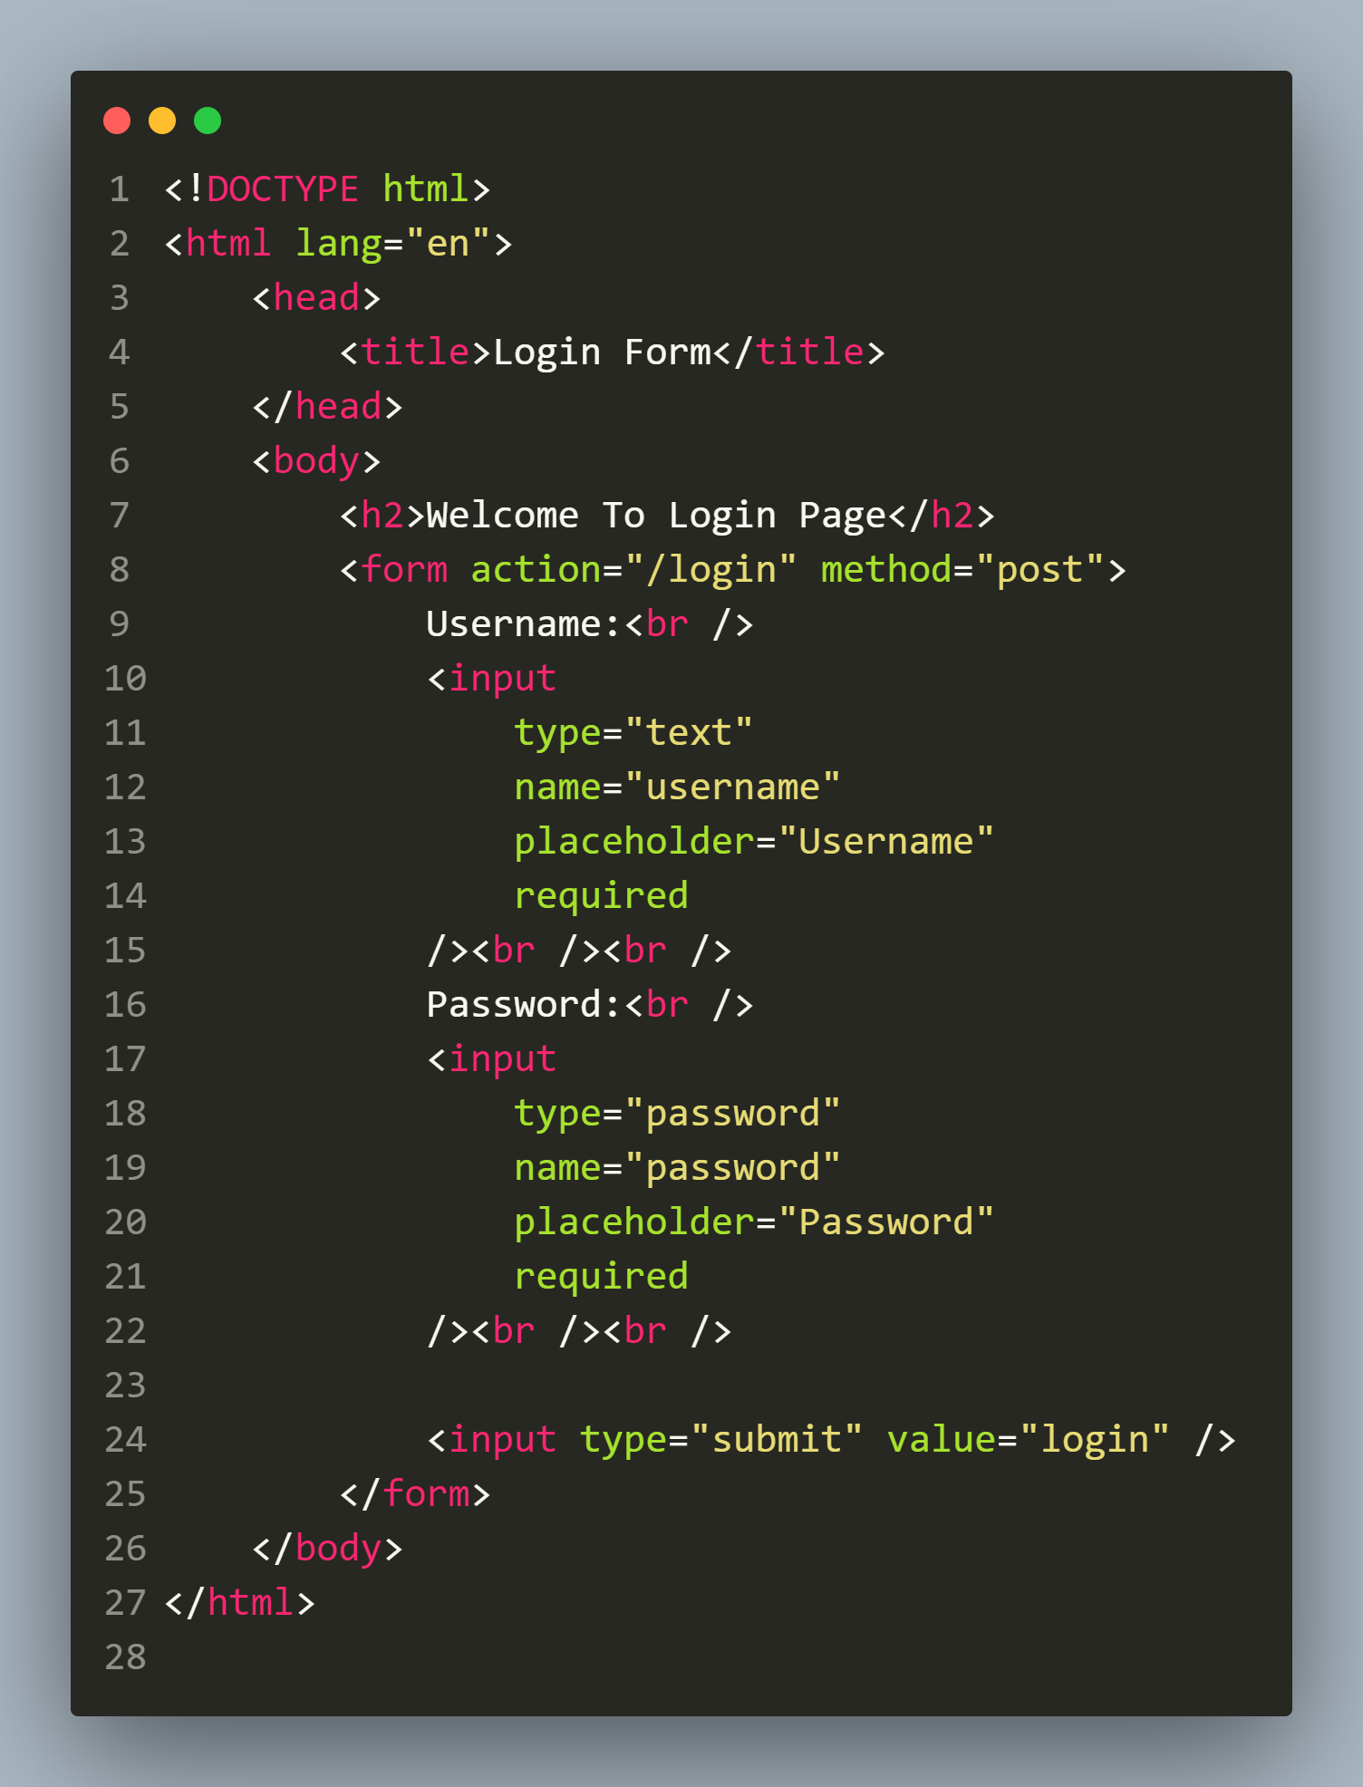
Creating html pages
public/login.html

Slide 14
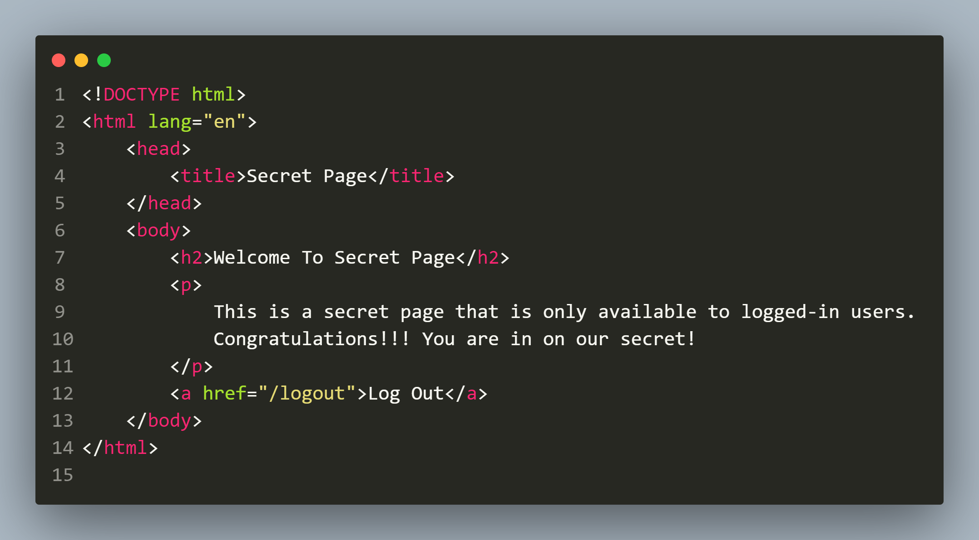
Creating html pages
public/secret.html

Slide 15
Developing our model
Now we will create our User model using passport-local-mongoose.
It will be almost same as our previous model files but with 2 new changes that you should figure out.

Slide 16
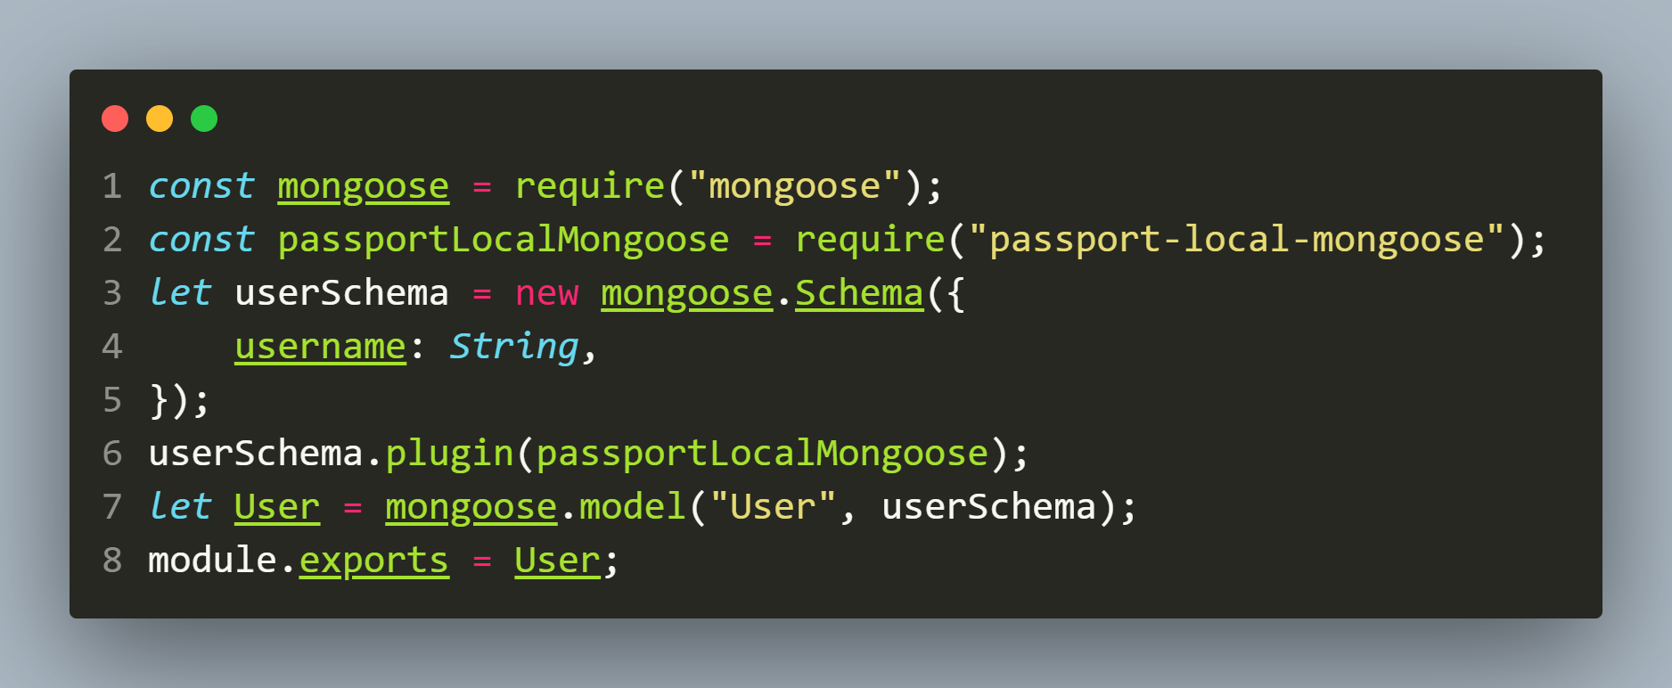
The user.js file
model/user.js

Slide 17
Important points about model
In this schema:
We didn’t add any field for passwords because passport-local-mongoose doesn’t need any password field.
Moreover , we're free to define our User how we like but passport-local-mongoose will add a username, hash and salt field to store the username, the hashed password and the salt value.
Additionally, passport-local-mongoose adds some methods to our Schema/Model.

Slide 18
Important methods added by passport-local-mongoose
Method | Description
register(user, password, cb) | Convenience method to register a new user instance with a given password. Checks if username is unique and generates an exception called UserExistsError if user is present
createStrategy() | Creates a configured passport-local LocalStrategy instance that can be used in passport.
serializeUser() | Generates a function that is used by Passport to serialize users into the session
deserializeUser() | Generates a function that is used by Passport to deserialize users into the session

Slide 19
Important exceptions added by passport-local-mongoose
Method | Message
UserExistsError | A user with the given username is already registered.
MissingUsernameError | No username was given.
MissingPasswordError | No password was given.
IncorrectUsernameError | Password or username are incorrect
IncorrectPasswordError | Password or username are incorrect

Slide 20
Adding some dummy users
To test our application, we will need some registered users in the DB.
So we will insert 2 records in the MongoDB database using register() method provided to us by passport-local-mongoose on our model.

Slide 21
Adding some dummy users
Syntax:
<Model>.register(obj,str,cb)
Explanation:
This method accepts an object as first argument containing all the fields mentioned in our Schema and their values.
The second argument to this method is password to be stored , to which salt and hash will be added.
The third argument is an optional callback.
We can also use register() method’s promise based version using async/await.

